Slide 1
Wireless Communications
Exercises, Examples, Problems
Spring 2012-13

Slide 2
Example 3.2
If a signal to interference ratio of 15 dB is required for satisfactory forward channel performance of a cellular system, what is the frequency reuse factor and cluster size that should be used for maximum capacity if the path loss exponent is
n = 4 ,
n = 3?
Assume that there are 6 co-channels cells in the first tier, and all of them are at the same distance from the mobile. Use suitable approximations.

Slide 3
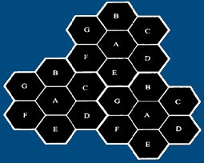
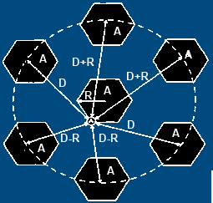

Solution to Example 3.2
a) For the case with n = 4
First, let us consider a 7-cell reuse pattern.
Using equation $Q=\frac{D}{R}=\sqrt{3N}$
the co-channel reuse ratio D/R = 4.583.
Using equation
$\frac{S}{I}=\frac{{\left(D/R\right)}^{n}}{i_{0}}=\frac{{\left(\sqrt{3N}\right)}^{n}}{i_{0}}$
Where $i_{0}$ is the number of Co-Channel interfering
cells. Hence, the Signal-to-Noise Interference ratio
is given by
S/I = ${\left[{\left(\text{4}\text{.}\text{583}\right)}^{4}\right] }/6$ = 75.3 = 18.06 dB.
Since this is greater than the minimum required S/I,
N = 7 can be used.

Slide 4

Solution to Example 3.2
b) For the case with n = 3:
First, let us consider a 7-cell reuse pattern. Using
$Q=D/R=\sqrt{3N}$
the co-channel reuse ratio D/R = 4.583. Using
$\frac{S}{I}=\frac{{\left(D/R\right)}^{n}}{i_{0}}=\frac{{\left(\sqrt{3N}\right)}^{n}}{i_{0}}$
Hence, Signal-to-Noise Interference ratio is given by
S/I = ${\left[{\left(\text{4}\text{.}\text{583}\right)}^{3}\right] }/6$ = 16.04 = 12.05 dB
Since this is less than minimum required S/I, we need to use a larger N.
Using $N=i^{2}+ij+j^{2}$, the next possible value of N is 12, (i=j=2).
The corresponding co-channel ratio is given by $Q=D/R=\sqrt{3N}=\sqrt{3×12}=6.0$
Then the signal-to-interference ratio is given by S/I = (1/6) x $6^{3}$= 36 = 15.56 dB
Since this is greater than the minimum required S/I, N = 12 can be used.

Slide 5
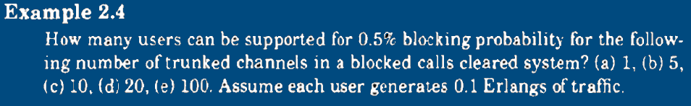
Example 3.4

Slide 6
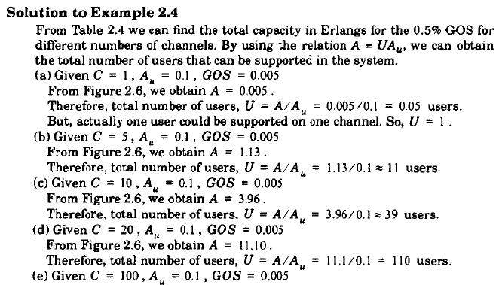
Solution to Example 3.4
From Figure 2.6, we obtain A = 80.9.
Therefore, total number of users, U = A/Au = 80.9/0.1 = 809 users.

Slide 7
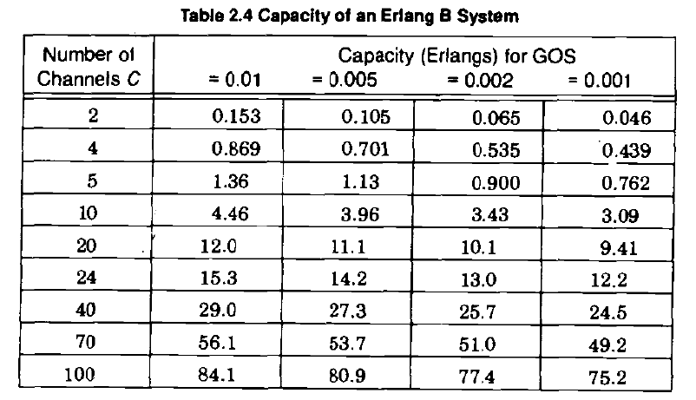
Table 3.4: Capacity of an Erlang B system

Slide 8
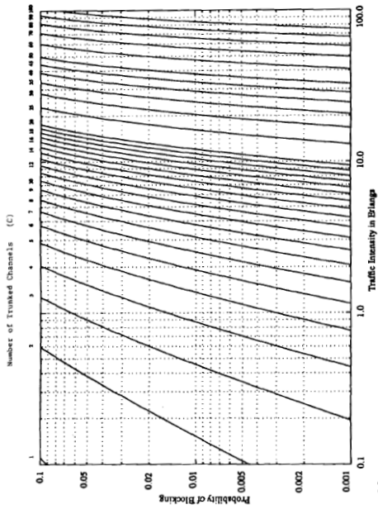
Figure 3.6

Slide 9
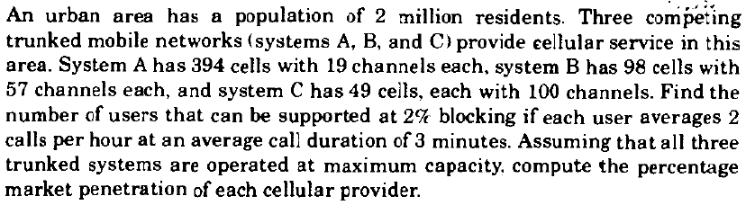
Example 3.5

Slide 10
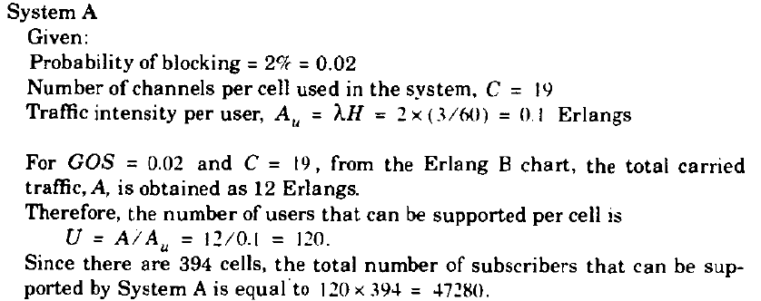
Solution 3.5

Slide 11
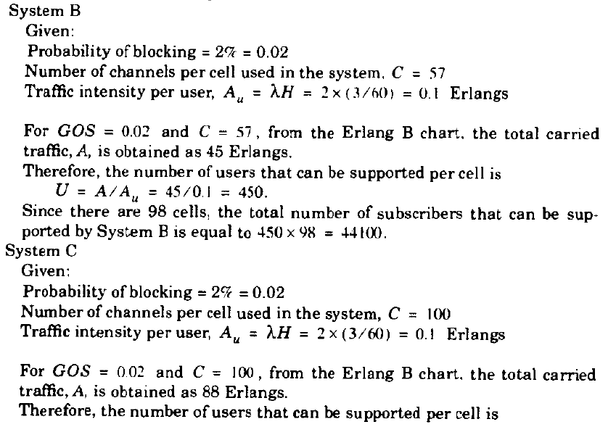
Solution 3.5

Slide 12
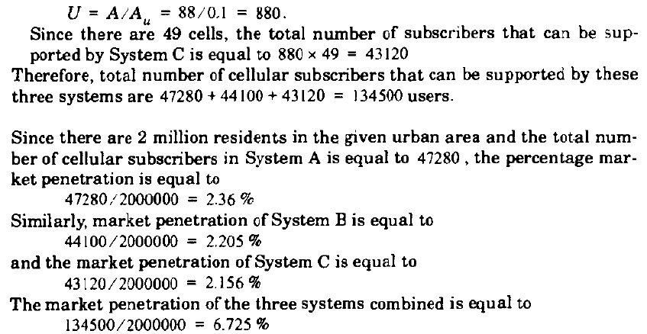
Solution 3.5

Slide 13
Example 3.6
A certain city has an area of 1,300 square miles and is covered by a cellular system using a 7-cell reuse pattern. Each cell has a radius of 4 miles and the city is allocated 40 MHz of spectrum with a full duplex channel bandwidth of 60 kHz. Assume a GOS of 2% for an Erlang B system is specified. If the offered traffic per user is 0.03 Erlangs, compute
the number of cells in the service area,
the number of channels per cell,
traffic intensity of each cell,
The maximum carried traffic;
the total number of users that can be served for 2% GOS,
the number of mobiles per channel, and
the theoretical maximum number of users that could be served at one time by the system.

Slide 14
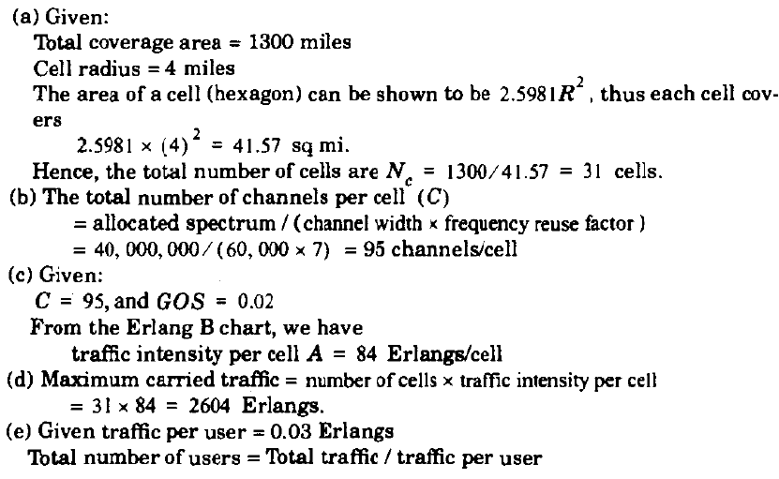
Solution 3.6

Slide 16
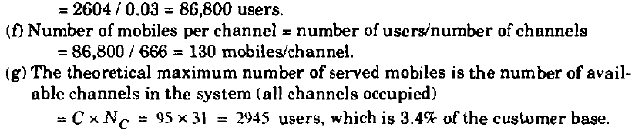
Solution 3.6

Slide 17
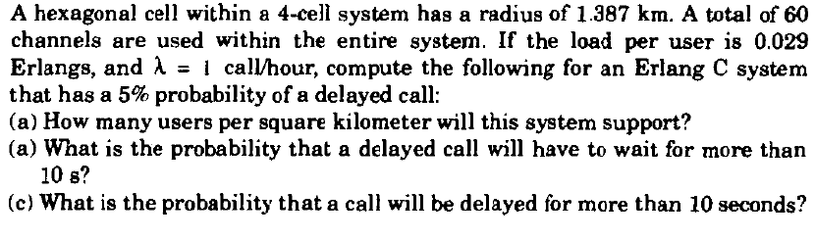
Example 3.7

Slide 18
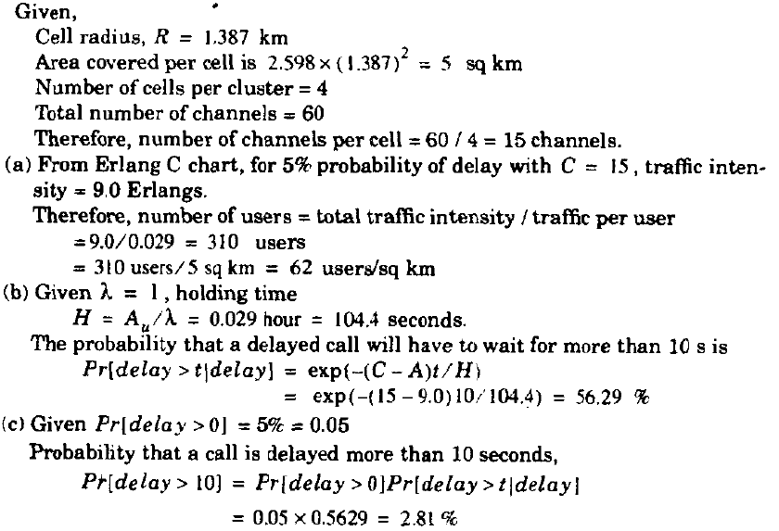
Solution 3.7

Slide 19
Question: Similar to Example 3.7
In a 7 cell/cluster system with a 2 km hexagonal cell radius, 70 channels are to be used. The traffic per user is aimed to be 0.05 Erlangs and the call per hour rate should be 1. For a 10% probability of calls being delayed in an Erlang C system, how many users can this system support in every square kilometer?

Slide 20

Answer: Similar to Example 3.7, pp.85
With a cell radius of 2 km, area covered per hexagonal cell is
2.598*(2)² =10.392 km². See Footnote 1.
Number of cells per cluster is = 7 & total number of channels is 70. Therefore, number of channels per cell is 70/7 = 10 channels/cell.
From Erlang C chart, for 10% probability of delay with 10 channels, traffic intensity in Erlangs is 6 Erlangs. Therefore, number of users = total traffic intensity / traffic per user = 6 / 0.05 = 120 users.
Number of users per km² = 120 / 10.4 = 11.54 users per km².
Footnote 1
The area of the center and wedge-shaped cells in the concentric circle geometry exceeds the area of a traditional hexagonal cell described in Chapter 3. Whereas a hexagonal cell occupies an area o
$$A_{hex}=\frac{\left(3\sqrt{3}R^{2}\right)}{2}=2.598R^{2}$$
Cells in concentric circle geometry each possess and area of $πR^{2}$m.

Slide 21
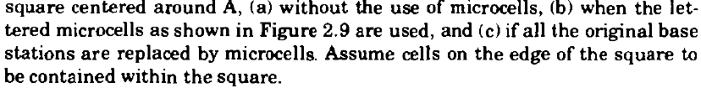
Example 3.8

Slide 22
Solution 3.8
(a) Without the use of microcells:
A cell radius of 1 km implies that the sides of the larger hexagons are also 1 km in length.
To cover the 3 km by 3 km square centered around base station A, we need to cover 1.5 km (1.5 times the hexagon radius) towards the right, left, top, and bottom of base station A.
This is shown in Figure 3.9. From Figure 3.9 we see that this area contains 5 base stations.
Since each base station has 60 channels, the total number of channels without cell splitting is equal to 5 x 60 = 300 channels.

Slide 23
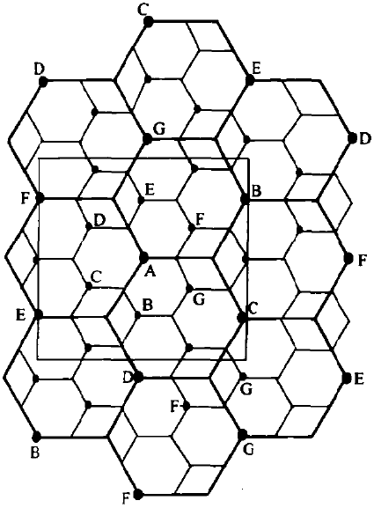
Figure 3.9:
illustration of cell
splitting within a
3 km by 3 km square
centered around
base station A

Slide 24
Solution 3.8
(b) With the use of the microcells:
In Figure 3.9, the base station A is surrounded by 6 microcells.
Therefore, the total number of base stations in the square area under study is equal to 5+6= 11
Since each base station has 60 channels, the total number of channels will be equal to
11 * 60 = 660 channels
This is a 2.2 times increase in capacity when compared to case (a)

Slide 25
Solution 3.8
c) If all base stations are replaced by microcells:
From Figure 3.9, we see that there are a total of
5+12=17 base stations in the square region under study
Since each base station has 60 channels, the total number of channels will be equal to
17 x 60 = 1020 channels
This is a 3.4 times increase in capacity when compared to case (a).
Theoretically, if all cells were microcells having half the radius of the original cell, the-capacity increase would approach 4.

Slide 26

Problem 3.1

Slide 27
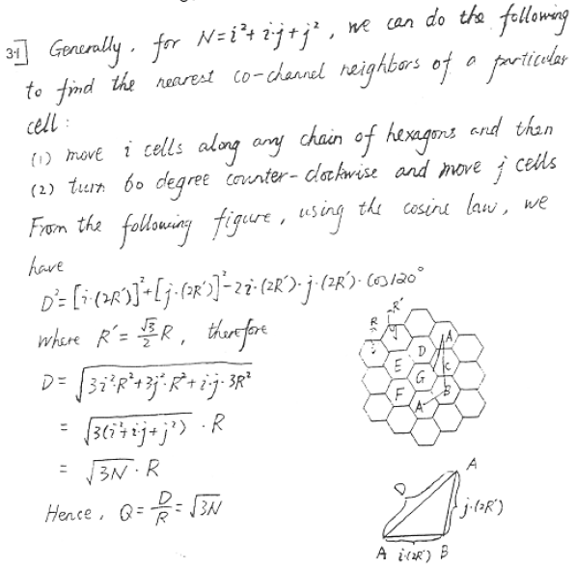
Solution 3.1

Slide 28
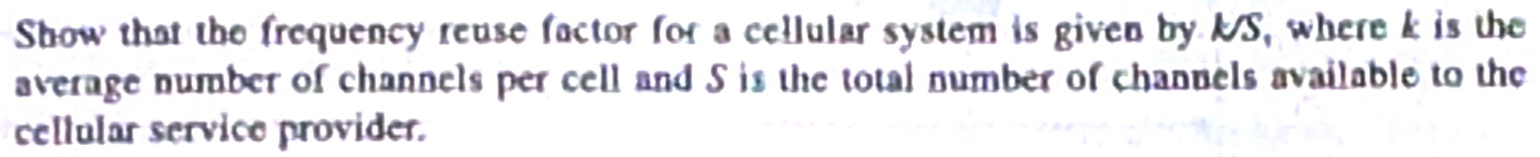
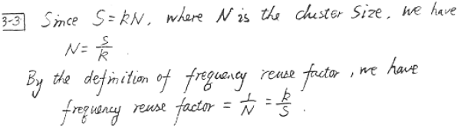
Problem 3.3
Solution 3.3

Slide 29
Probnlem 3.4
If 20 MHz total spectrum is allocated for a duplex wireless cellular system and each simplex channel has 25 kHz RF bandwidth, find
The number of dupplex channels
The total number of channels per cell site if N=4 cell reuse is used.

Slide 30
Solution 3.4
a) The number of simplex channels i
20*10^6 / 25*10^3 = 800
Then, number of duplex channels is 800/2=400
The total number of channels per cell site if N=4 cell reuse is used is
400/4 = 100.

Slide 31
Problem 3.5
A cellular service provider decides to use a digital TDMA scheme which can tolerate a signal-to-interference ratio of 15 dB in the worst case. Find the optimum value of N for
Omnidirectional antenna
120 degrees sectoring amd
60 degrees sectoring.
Should sectoring be used? İf so, which case, 60 or 120 degrees) should be used? Assume a path loss exponent of n = 4 and consider trunking efficiency).

Slide 32
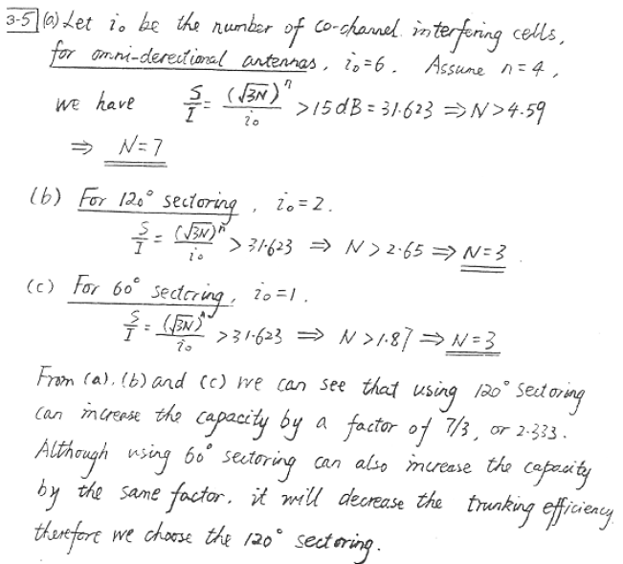
Solution 3.5

Slide 33
Problem 3.10
An FDD cellular telephone system that uses two 30 kHz simplex channels to provide full duplex voice and control channels is allocated a total of 24 MHz of bandwidth. Assume that each mobile phone user generates 0.1 Erlangs of traffic in accordance with Erlang B.
For a 4-cell re-use system, find the number of channels in each cell.
What is the maximum number of users that can be supported per cell if each cell is to offer capacity that is 90% of perfect scheduling? Assume that omnidirectional antennas are used at each base station.
When the maximum number of users are available in the user pool, what is the blocking probability of the system in part b)?
If each cell uses 120º sectoring for each user base station, what is the new total number of users that can be supported per cell for the same blocking probability as in c)?
When each cell covers 5 square kilometers, how many subscribers could be supported in an urban market that is 50km * 50 km for the case of omnidirectional base station antennas?
If each cell covers 5 square kilometers, than how many subscribers could be supported in an urban market that is 50km * 50 km for the case of 120º sectored antennas?

Slide 34
Solution 3.10
Number of channels in the whole system
C = 24 MHz / (2 * 30 kHz) =400 channels,
Channels / cell = 400 channels / 4 cells = 100 channels/cell

Slide 35
Solution 3.10
b) 90% of 100 Erlangs is 90 Erlangs.
Recalling that
traffic intensity offered by each user = call request rate * holding time ==> A_{u} = λH
That is, each user generates a traffic intensity of A_{u} Erlangs is given by A_{u} = λH, where H is the average duration of a call and λ is the average number of call request per unit time for each user. For a system containing U users and unspecified number of channels, the total offered traffic intensity A is given as
A = U A_{u}
Where U is the number of users in the system and A_{u} is the traffic generated by each user. In a C channel trunked system, if the traffic is equally distributed among the C channels, then the traffic intensity per channel A_{c} is given by
A_{c} = U A_{u} / C
Therefore, 90 = U A_{u} = U (0.1) ==> U = 900 users, where A_{u} is the generated traffic in Erlangs.

Slide 36
Solution 3.10
With the offered traffic 90 Erlangs and number of channels c =100, from Figure 3.6, we read 0.03, that is the 3% GoS.
Each sector has 100/3 = 33.3 channels; GOS=3%, from Figure 3.6, 25 Erlangs/sector is obtained. Then we have, A = U A_{u} /sector => 25= U A_{u} (per sector) => with A_{u} = 0.1 (given), the number of users is
U = 250 /sector or U = 250 /sector *3 sector = 750 users.
e) Total area to cover is 50km*50km = 2500 km². Dividing this by 5 km² /cell, we obtain 2500/5 = 500 cells. Then, total #users = 900 users/cell * 500 cells =900*500 = 450,000 users.
f) 500 cells => 500 cells * 750 users/cell = 500*750 users = 375,000 users

Slide 37
Problem 3.29 (Rappaport)
3.29 - Pretend your company won a license to build a U.S. cellular system (the application cost for the license was only $500!). Your license is to cover 140 square km. Assume a base station costs $500,000 and a MTSO costs $1,500,000. An extra $500,000 is needed to advertise and start the business. You have convinced the bank to loan you $6 million, with the idea that in four years you will have earned $10 million in gross billing revenues ,and will have paid off the loan. a- How many base stations (i.e., cell sites) will you be able to install for $6 million? b- Assuming the earth is flat and subscribers are uniformly distributed on the ground, what assumption can you make about the coverage area of each of your cell sites? What is the major radius of each of your cells, assuming a hexagonal mosaic?
c- Assume that the average customer will pay $50 per month over a four year period. Assume that on the first day you turn your system on, you have a certain number of customers which remains fixed throughout the year. On the first day of each new year, the number of customers using your system doubles and then remains fixed for the rest of that year. What is the minimum number of customers you must have on the first day of service in order to have earned $10 million in gross billing revenues by the end of the 4th year of operation?
d- For your answer in (c), how many users per square km are needed on the first day of service in order to reach the $10 million mark after the 4th year?

Slide 38

Solution 3.29
a- How many base stations (i.e., cell sites) will you be able to install for $6 million?
Loan in question is given and equal to ($6x${10}^{6}$).
Cost of MTSO $C_{MTSO}$ = $1500,000.
Cost of abase station ($C_{bs}$) =$500,000.
Cost of advertisement ($C_{ad}$) =$500,000.
In this case the number of base stations we are able to install for $6 million are:
No of base stations $=\frac{loan − C_{MTSO }− C_{ad}}{C_{bs}}$ $=\frac{6x{10}^{6} −1500,000 −500,000}{500,000}$ = 8

Slide 39

Solution 3.29
b- Assuming the earth is flat and subscribers are uniformly distributed on the ground, what assumption can you make about the coverage area of each of your cell sites? What is the major radius of each of your cells, assuming a hexagonal mosaic?
Now number of the base stations are equal to (8) and the total coverage area is equal to (140 K$m^{2}$),
The average area of each cell $=\frac{\text{T}\text{otal} \text{coverage} \text{area}}{\text{N}\text{umber} \text{of} \text{the} \text{base} \text{stations}}$
The average area of each cell $=\frac{\text{140}}{\text{8}}$ = 17.5 k$m^{2}$
The average area of each cell = 2.6 $×$ $R^{2}$
R = $\sqrt{\frac{\text{The} \text{average} \text{area} \text{of} \text{each} \text{cell}}{2.6}}$ = $\sqrt{\frac{\text{17}\text{.}\text{5}}{2.6}}$ = 2.6 Km

Slide 40

Solution 3.29
c- Assume that the average customer will pay $50 per month over a four year period. Assume that on the first day you turn your system on, you have a certain number of customers which remains fixed throughout the year. On the first day of each new year, the number of customers using your system doubles and then remains fixed for the rest of that year. What is the minimum number of customers you must have on the first day of service in order to have earned $10 million in gross billing revenues by the end of the 4th year of operation?
Each customer will pay (P) = ( 50 x 12) = $600. Assume the number of customers on the first day is (U), the gross billing revenues by the end of the 4th year of operation is:
G= (U +2U +4U +8U) $×$P = 15U $×$P
G $≥$ $10 $×$ ${10}^{6}$
15UP $≥$ 10 $×$ ${10}^{6}$
U $≥$ $\frac{10x{10}^{6}}{15 x P}$ = $\frac{10x{10}^{6}}{15 x 600}$ = 1111.1
The minimum number of customers on the first day of service is ( 1112)

Slide 41

Solution 3.29
d- For your answer in (c), how many users per square km are needed on the first day of service in order to reach the $10 million mark after the 4th year?
------------------------------------------------------------------------------------------------------
The number of users per square Km $=\frac{1112}{140}$ = 8 users $/km$

Slide 42
Example 4.1
Find the far-field distance for an antenna with maximum dimension of 1 m and operating frequency of 900 MHz.

Slide 43

Solution 4.1
Given:
Largest dimension of antenna, D = 1 m
Operating frequency f = 900 MHz,
λ = c/f = (3 * ${10}^{8}$ m/s) / (9 * ${10}^{8}$ /s) = 1/3 m
Using equation (4.7.a), far-field distance is obtained as
$$d_{f}={2 D^{2}}/{\text{λ}}={2 1^{2}}/{\text{1}\text{/}\text{3} }=6 m$$

Slide 44

Example 4.2
If a transmitter produces 50 watts of power, express the transmit power in units of
dBm,
dBW.
If 50 watts is applied to a unity gain antenna with a 900 MHz carrier frequency, find the received power in dBm at a free space distance of 100 m from the antenna.
What is $P_{r}$ (10 km)? Assume unity gain for the receiver antenna.

Slide 45
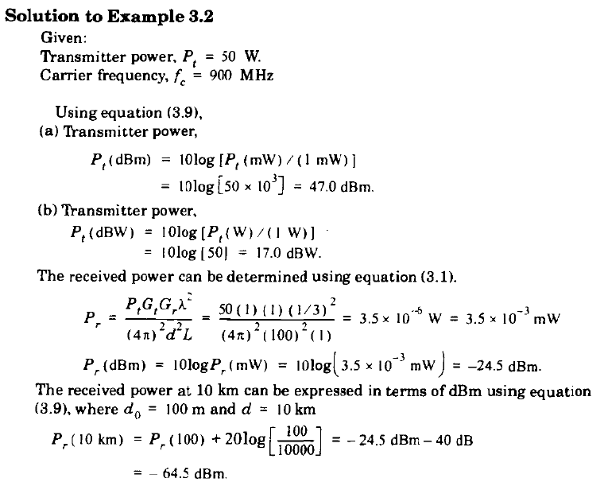
Solution 4.2

